Slide 1






January GBM!!!
Depaul sasa

Slide 2
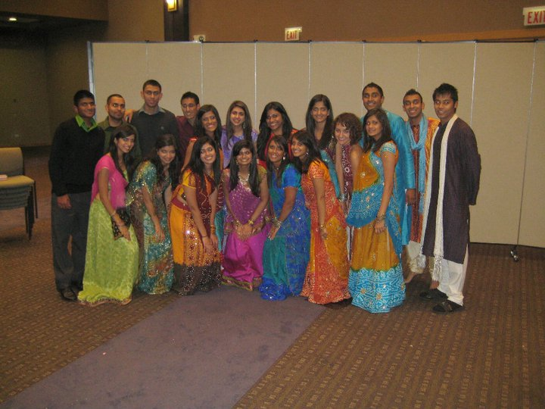
Membership
Membership fee is $15
Receive a free SASA t-shirt
Discount to certain events!
Must be a member to be in the show
See Angeline or Sabina to become a member today!
@ 50% Price rises to $20

Slide 3
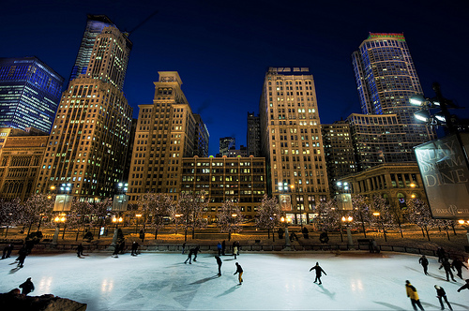
Ice skating Event!
Ice Skating
When: January 14th
Time:
Where: Grant Park, Chicago
Signing up:
Ice Skating rentals:
Come out and have some fun on the ice with us!
When: January 14th
Time: 4-7pm
Where: Grant Park, Chicago
Ice Skating is FREE!
Come out and have some fun on the ice with us!
Sign up with Sahrish Moyeed
Notes:
Signing up who’s free and whatnot, do they have to pay for rentals

Slide 4
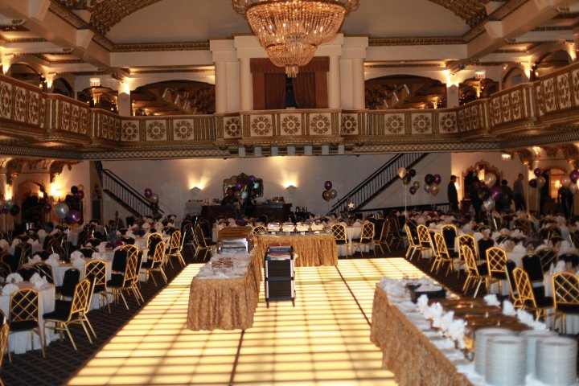
Semi Formal!
What: SASA and FFE are hosting a Semi Formal!
Where: MPR in the Student Center
When: Friday February 4th
Time:
*7:30-8:00pm:Cocktail hour
*8:30-10:00pm:Dinner
*10:00-12:00am:Dancing
Tickets: $15: single
$25: couple
Attire: Formal Wear (cocktail
dresses for the ladies, shirt and tie
for the boys)
Notes:
Do we need to outline the times?

Slide 5
SHOW ! ! !

Slide 6



And the Theme for Show is…
Bollywood Meets Hollywood
: Where Stars Align!

Slide 7
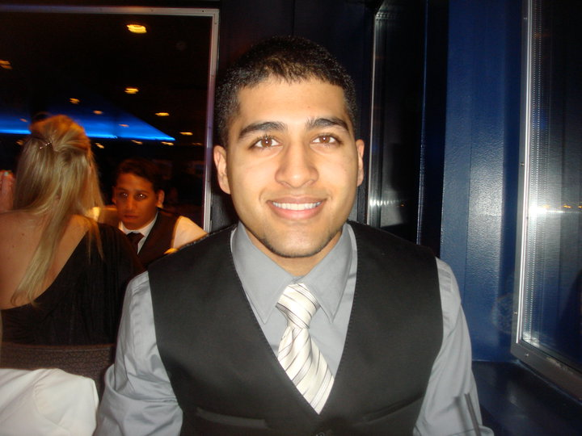
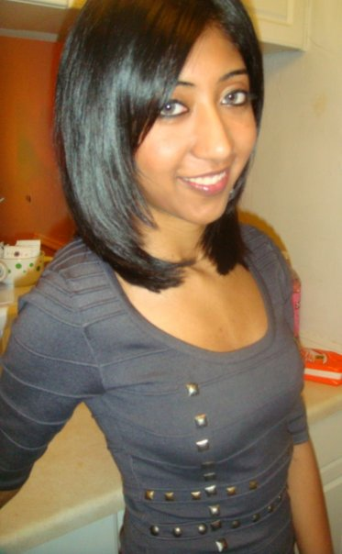

Emcees
Congratulations to Asad Mobin, Sarah Mobin, & Sharup Karim!!!!!!
Notes:
Does anyone have a picture of Sharup by any chance?

Slide 8
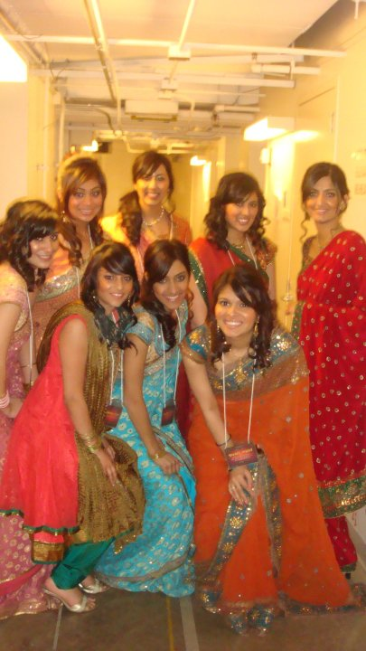
Fashion Show
When: Tuesday January 11th (tomorrow!)
Time: 9:30pm
Where: SC 313
Fashion show coordinators: Sahrish Qureshi and Monica Patel
If you are interested in participating in the fashion show come tomorrow!

Slide 9
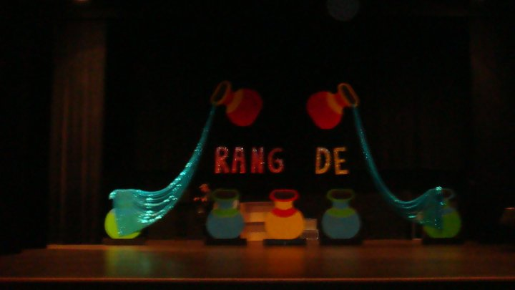
Show Committee
When: Wednesday, January 12th
Time: 9:30pm
Where: SC 314AB
If you are interested in helping out with the set and decor in show, please come to this meeting or contact a show coordinator at dpusasa.showchair2@gmail.com

Slide 10
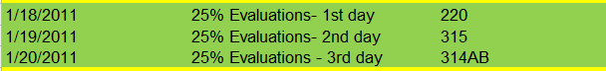
25% Evaluations
Dates:
Similar to try-outs, so be prepared!
Must be 25% of your music, and you must bring your mix with you
Will have 20 min time slots to setup and perform for Show Chairs
SIGN UP FOR TIME SLOTS AFTER THE MEETING

Slide 11
Important Dates
February GBM - February 7th
50% evaluations - February 8th, 9th, 10th
March GBM - February 28th
75% evaluations - March 1st, 2nd, 3rd
100% evaluation - Sun April 3rd in MPR 2pm
April GBM - April 11th
Show Rehearsal - Friday April 15th @ NSCPA
Show Date - Thursday, April 16th @ NSCPA
These dates are MANDATORY for all participants

Slide 12

Show Rules!
NO ALCOHOL!
  If we catch you drinking at ANY SASA event or meeting you WILL be kicked out of the show!
Plan Ahead
  You will be aware ahead of time of all meetings’ dates and times; therefore, plan accordingly (re: school)
Strike Policy
  If you miss more than 1 GBM you will be participating in a SASA community service event in mid-march
    If you are going to miss a meeting, please let the show coordinators know at least 2 days before the meeting.
  **This policy applies to fashion show rehearsals and act coordinator meetings!
Please Be Respectful during Rehearsals and Meetings

Slide 13
Act Guidelines
1. Song selection is on a first come, first serve basis
  No two groups can have any identical songs
2. No song from last year’s show can be used in your act
  For a full list of these songs contact a show chair
3. Act can be NO longer than 6 minutes
4. No more than 1 minute of your act can consist of Hip-Hop music (Non-South Asian)
5. The maximum amount of participants per act is 16 people
6. Only the FIRST full Hip-Hop act application turned in will be accepted!
  Act can have up to 6 minutes of Hip-Hop music
  Act proposal must adhere to all guidelines to be applicable
7. Only up to TWO Alumni/Non-DePaul acts will be accepted!
  Alumni are defined as graduates of DePaul University
  Non-DePaul is defined as an act consisting of more than 50% Non-DePaul Students
    i.e. Loyola, UIC, Northwestern students etc.
  In the event of more than two proposals of this nature, the proposals will be evaluated at the discretion of the Show Chairs

Slide 14
Room Reservations
* Email Priyal Patel at dpusasa.secretary@gmail.com
* Student Center, SAC and Munroe Rooms
* Can't use Ray rooms under SASA's name
* Policy:
* Book room at least 2 weeks prior
* Cancel at least 10 days prior
* Don't show up once = no longer allowed to use rooms
* ROOMS FILL UP FAST!!!

Slide 15

Interested in Tech?
If you interested in learning how the lights and sound work during the show and would be interested in helping with tech, contact one of the show chairs!

Slide 16
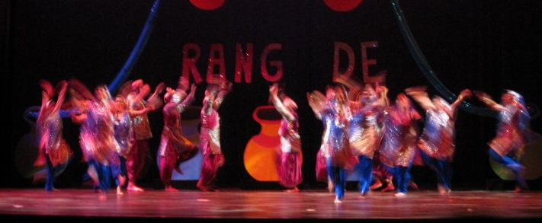
Want to be in an act?
Contact Dhara Thakkar at dpusasa.showchair2@.com or see her after the meeting if you're interested in being in the show but don't know where to start
Bhangra, Raas, and More

Slide 17

Rang De: Show DVD’s
Didn’t get a show DVD yet?
Full length DVD including Videos, MC Skits, and Acts
You can purchase one after the meeting from Sabina Samra for only $5!

Slide 18
www.Depaulsasa.yolasite.com
Join our Facebook
Group today!
DePaul SOUTH ASIAN
STUDENTS ASSOCIATION

